Slide 1
Experimental Design
Analysis of suicide rates from year 1985 to 2015.
By sajith gowthaman

Slide 2

Why This experiment
Suicide is a global issue, and we have been witnessing a number of victims regardless of their social economy status
Close to 800,000 people die due to suicide every year.
It is the third leading cause of deaths in 15-19 years.
There is one death by suicide in every 12 minutes ( Just in USA).

Slide 3
Aim of the project
A data of suicide rates from Kaggle is taken to analyse and find the impacts of various categories (age, gender, gdp for year, population,etc) on the suicide rate.
Test a null hypothesis with the help of Kruskal wallis test, t-tests
Ho: The number of suicide rate will remain constant in male and female through the years 2000 to 2015.
Ha: There will be a positive and significant increase in the number of suicides by male and female from 2000 to 2016.

Slide 4
METHOD OF TESTING
Data Cleaning
Visualization of different categories vs suicide numbers.
Normality Test
Confidence Interval

Slide 5
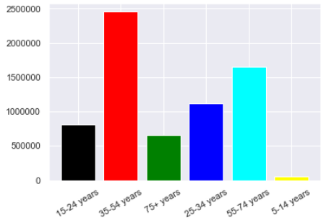
Effect of age on suicide rate
Age was plotted against year to find the leading age category that is affected.
Years 35-54 had the highest suicide numbers with a sum of over 2.5 M.

Slide 6
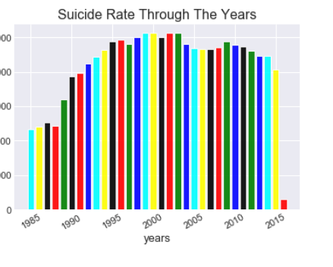
Suicide Rates through the years
The suicide rates peaked during the years 2000 to 2005.
The suicide rate has increased from the 1985 to 2000.

Slide 7
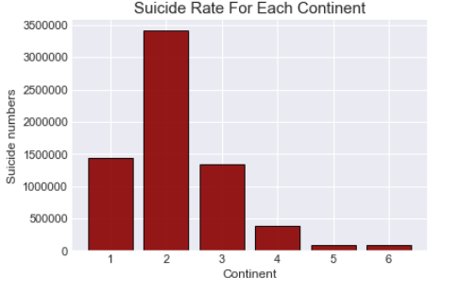
Suicide rate in different continents
1- Asia, 2- Europe, 3-North America, 4-South America, 5-Australia, 6-Oceania
European countries are the most to be victimized.

Slide 8
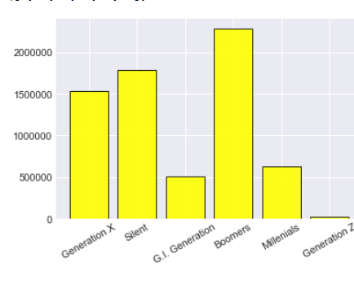
Different generations vs suicide rate
Generations that were most affected were Boomers, Generation X.

Slide 9
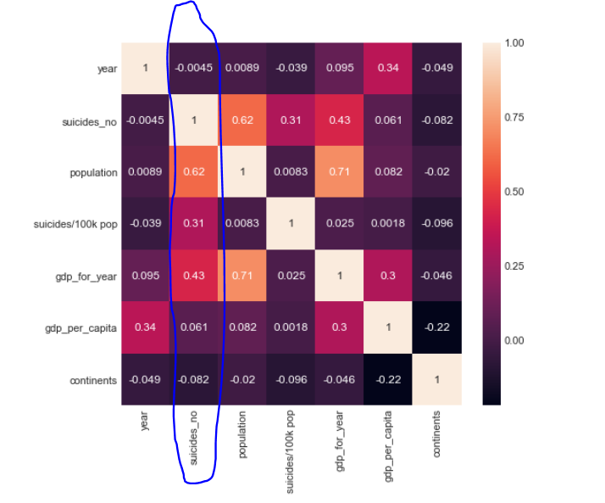
Heat map
Heat map was plotted to determine the correlation of all the categories such as gdp for year, suicides/100k, etc.

Slide 10
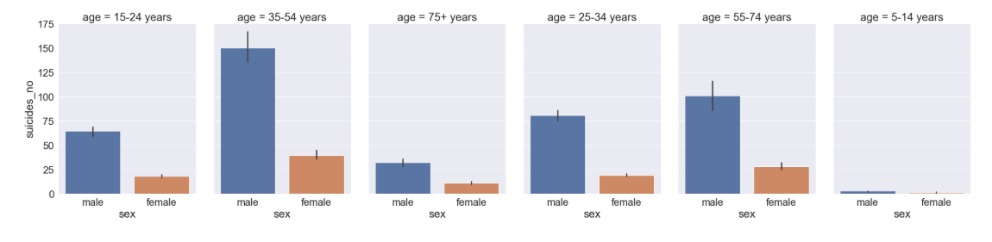
Gender and age vs suicide rate

Slide 11
Hypothesis testing
At first, the hypothesis was tested individually from year 2010 and year 2015 for normality, and the test was rejected.
Next we grouped 5 years in on, from 2000 to 2005 and 2010 to 2015 and checked for normality.
The values were P = 0 and w = 0.22 and 0.29. Kurtosis value was as high as 171.808 and 78.87. This clearly shows that the test should be rejected.

Slide 12
The distribution being non normal, we proceeded with the Kruskal Wallis test that resulted in static value of 9.32 and p-value of 0.002.
Then, the 95% confidence interval was found, suicides from year 2000 to 2005 have suicide rates on average between 36.55 and 27.65 suicide/year higher than suicides from 2010 to 2015.

Slide 13
Factors that could have caused a bias:
The population of different countries varies with different size, weather, population and and size ratio could possibly affect the research.
The gender is only classified as male and female, however, there are more than just that.
No data about their mental well being is given, and also no information about their health.

Slide 14
Questions?

